Slide 1


Putting the Fast in fast.ai – Machine Learning Models in 15mins
Akanksha Malik
@akankshamalik96

Slide 2



Slide 3
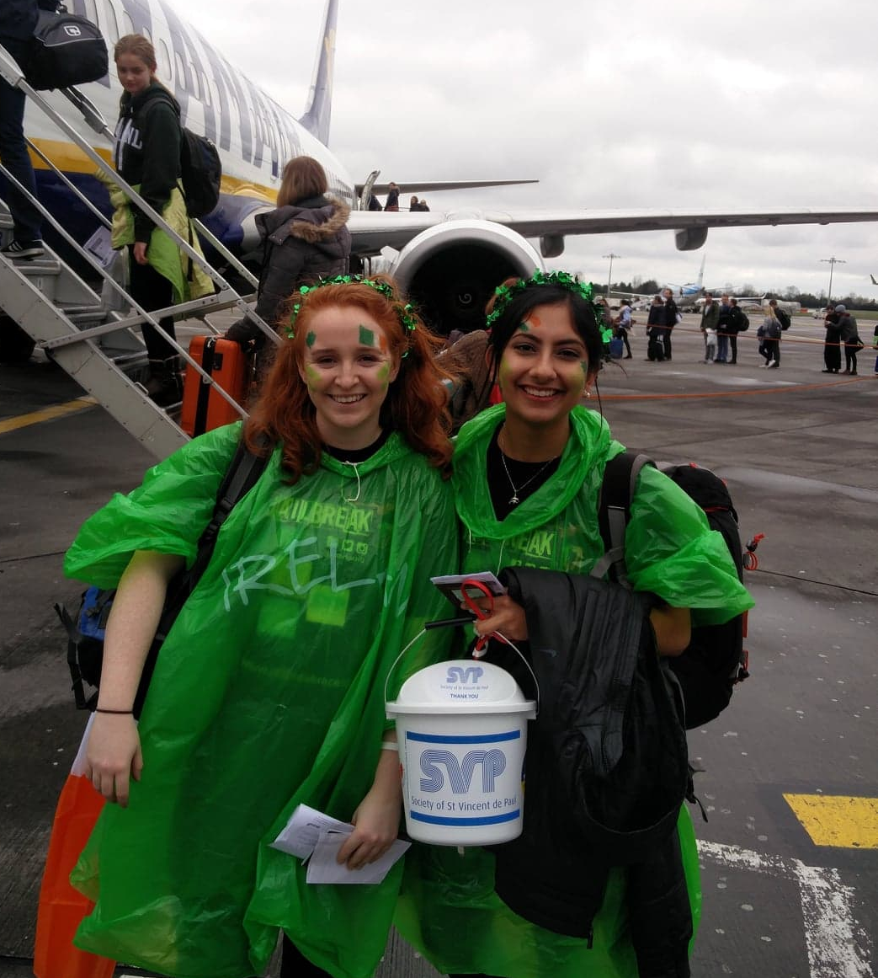
A little bit about me…

Slide 4
Artificial Intelligence
Machine Learning
?
Machine Learning
Deep Learning
Notes:
AI: a program that can sense, reason, act and adapt
ML: algorithms whose performance improve as they are exposed to more data over time
DL: subset of machine learning in which multilayered neural networks learn from vast amounts of data

Slide 5
fast.ai

Slide 6


Transfer Learning
Notes:
AI: a program that can sense, reason, act and adapt
ML: algorithms whose performance improve as they are exposed to more data over time
DL: subset of machine learning in which multilayered neural networks learn from vast amounts of data

Slide 7
fast.ai
Natural Language Processing
Computer Vision

Slide 8
Setup
Data Science VM
Jupyter Notebooks
Notes:
Logos/written out

Slide 9
Thank You for Listening!
Any questions?
https://github.com/akankshamalik/ whatbearisit

Slide 10
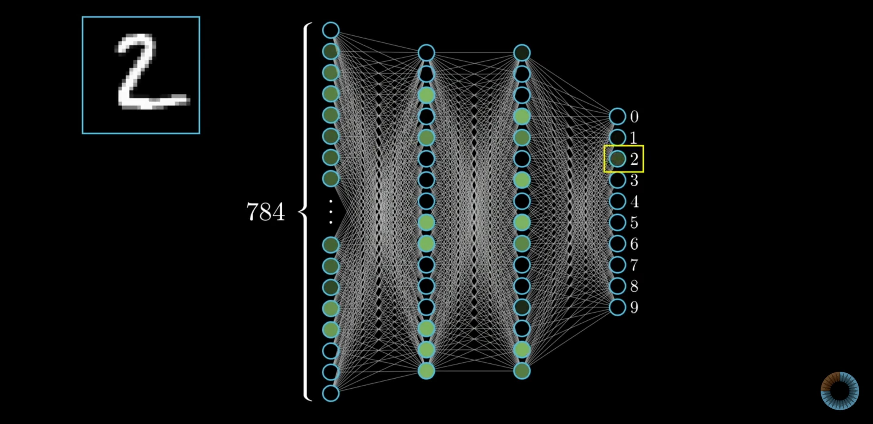
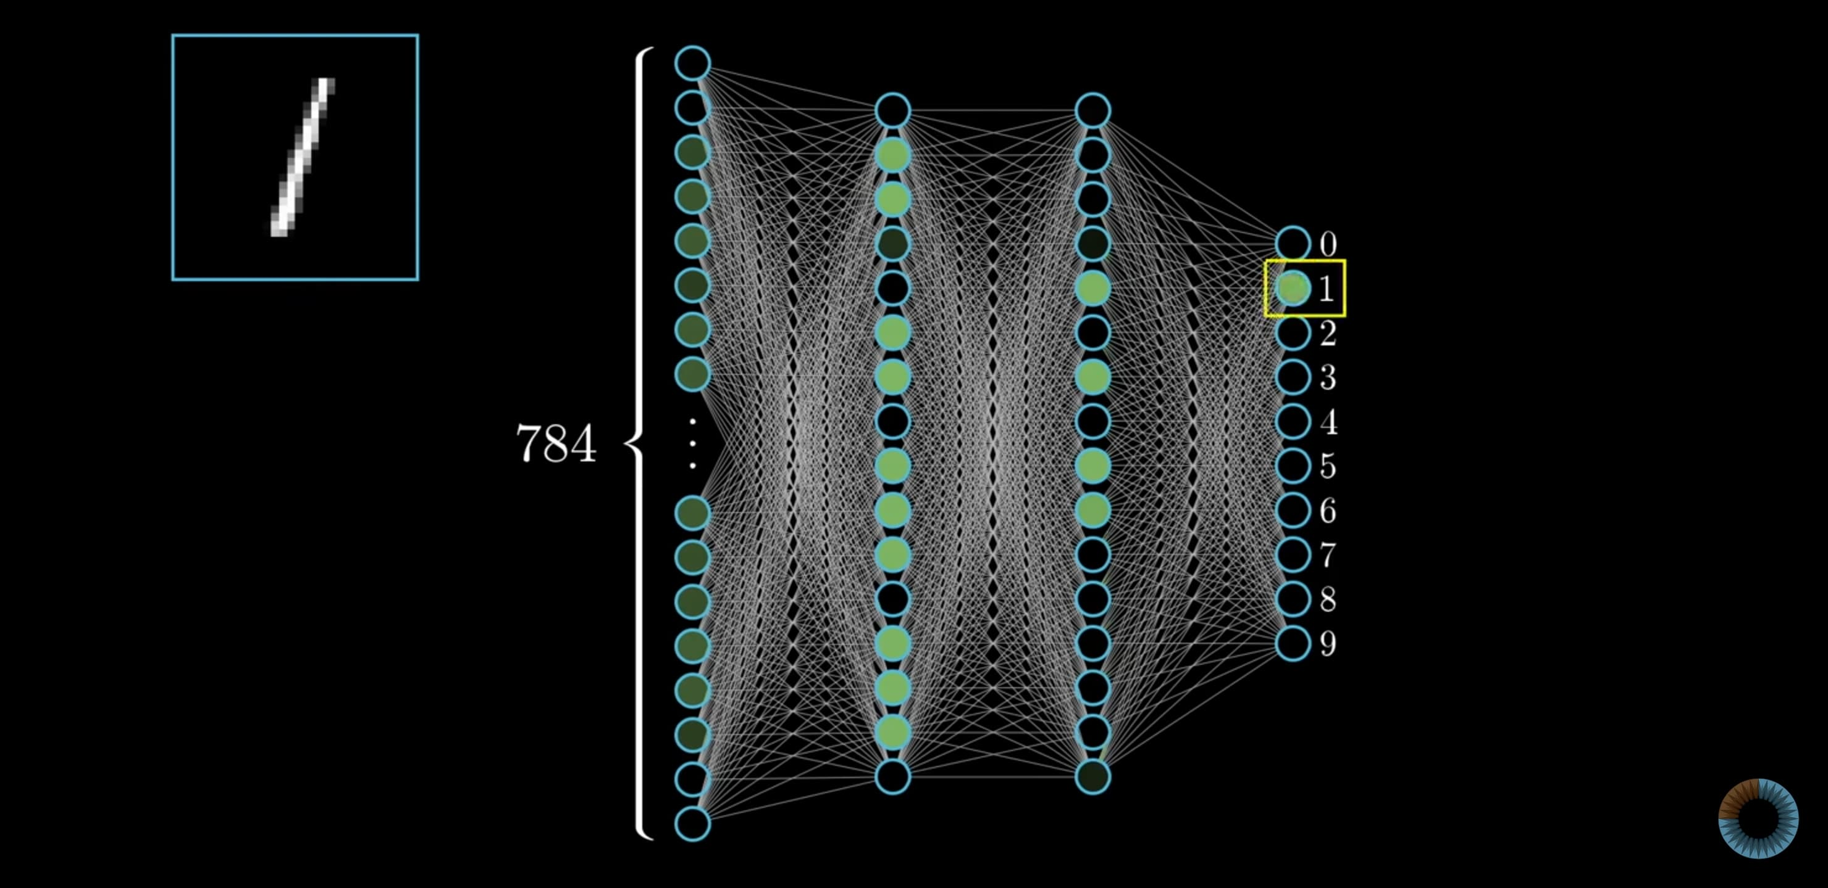
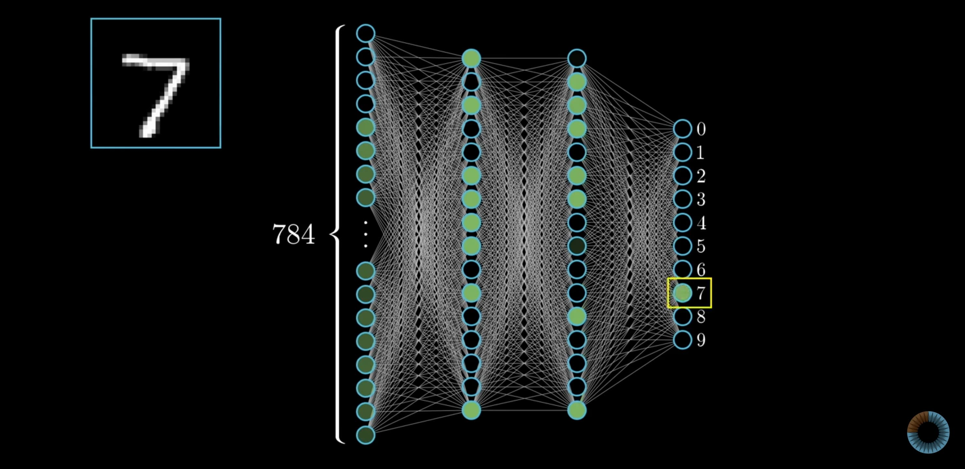
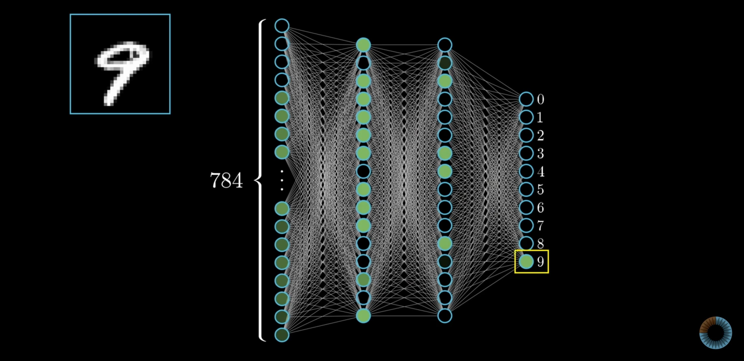

Slide 11
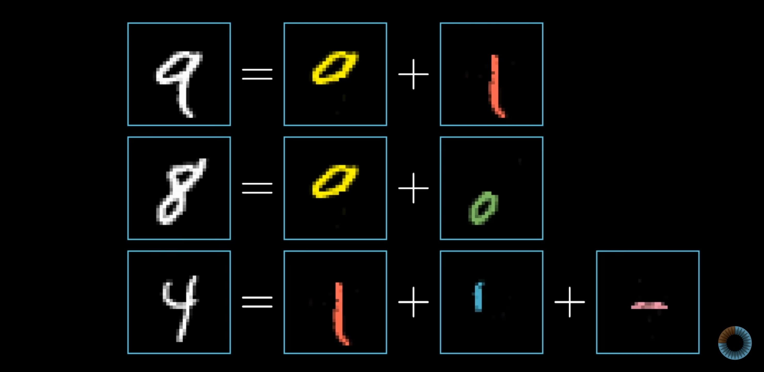

Slide 12
